Slide 1

Machine Learning Project Predicting the GDP Evolution
Stelios Katsoulakis
March 29th , 2026

Slide 2
Agenda
Problem Statement – Project Details
Getting to know the data
Limitations and Improvements
Forecasting

Slide 3
Agenda
Problem Statement – Project Details
Getting to know the data
Limitations and Improvements
Forecasting

Slide 4
Project Details From where did we get the data and what did it include?
GDP and Population data downloaded from World Bank website
60+ years of history starting from 1960
Non-country entities in data (European Union)
250+ countries, regions and economic blocs examined
13,500+ data points/observations used

Slide 5
Agenda
Problem Statement – Project Details
Getting to know the data
Limitations and Improvements
Forecasting

Slide 6
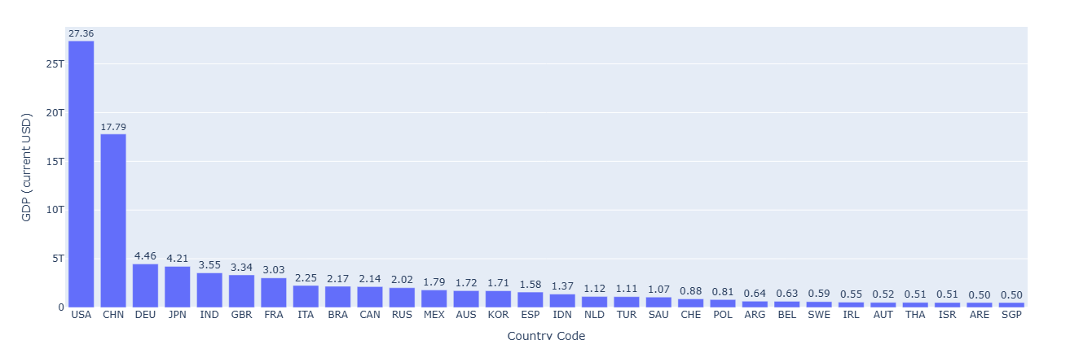
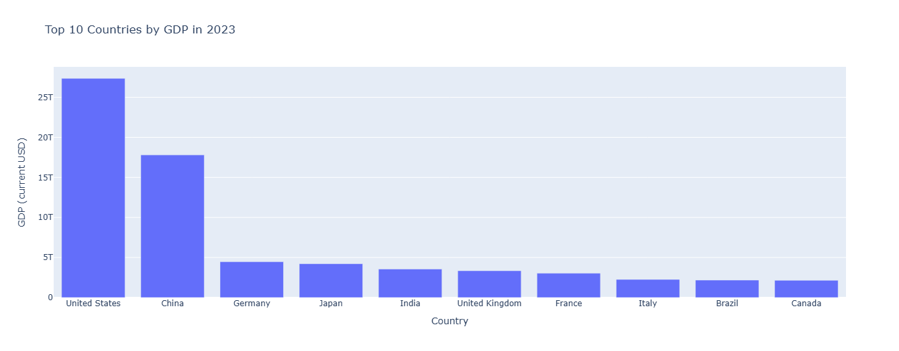
Getting to know the data: GDP per country US and China the countries with highest GDP by far; >3 times as high when compared to 3rd Germany
Gross Domestic Product (in Trillion USD)
Top-30 Countries, 2023

Slide 7
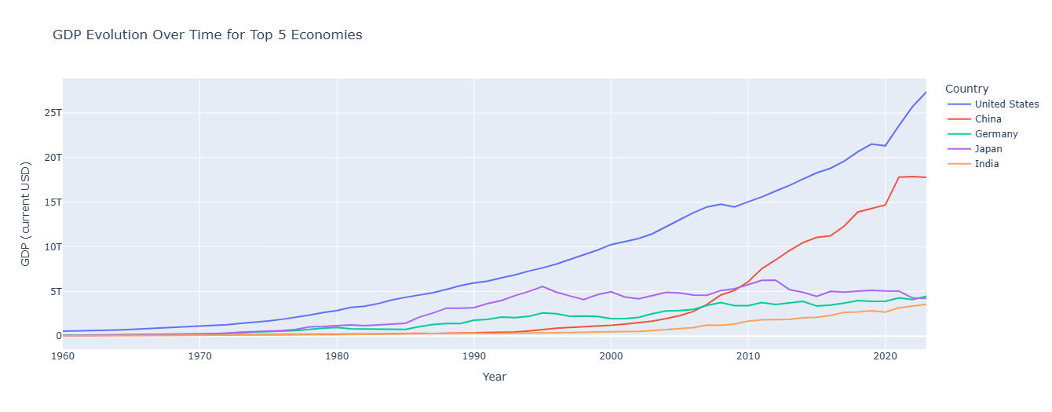
Getting to know the data: GDP Growth per major Country US and China with highest overall growth over the past 60 years albeit with flattening trends recently
US steady growth with a CAGR of 6.4%
China’s growth “exploded” since 2000 although with major slow-down in the past two years
Japan GDP, although with high growth until 1990, remains almost flat since then
Germany with small but steady growth and a CAGR of 6.5%
India GDP grew exponentially since 2000 at a CAGR of 7.51%
CAGR (1960-2023) | USA | China | Germany | Japan | India
 | 6.42% | 9.46% | 6.50% | 7.38% | 7.51%

Slide 8
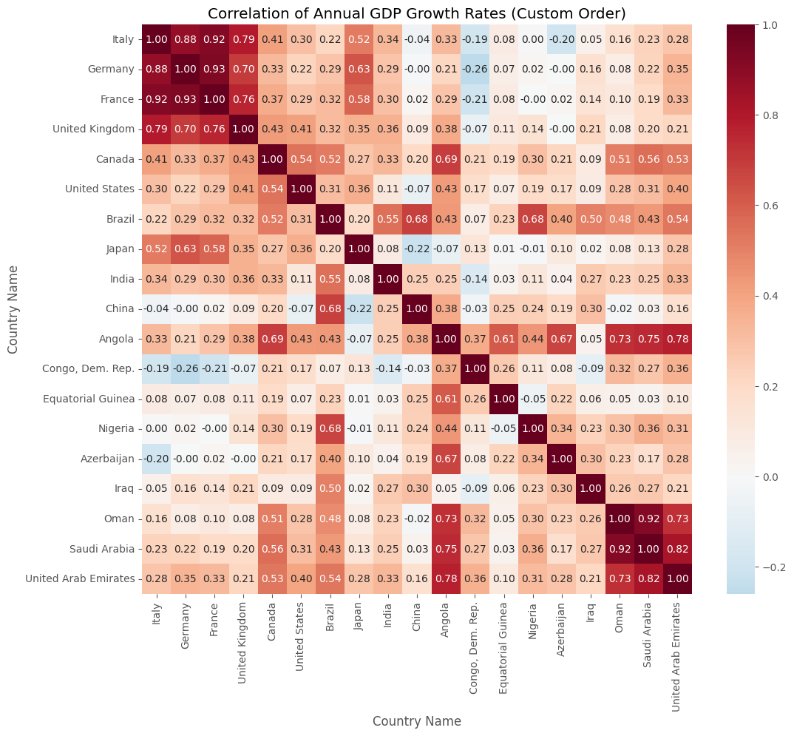
Getting to know the data: GDP Growth correlation matrix GDP growth within certain country groups highly correlated
Europe
European countries’ GDP growth very strongly correlated
Middle East countries with high growth correlation
China growth patterns not correlated with other major economies but Brazil
India and Japan growth more correlated with EU countries vs. US
North America
Middle East

Slide 9
Agenda
Problem Statement – Project Details
Getting to know the data
Limitations and Improvements
Forecasting

Slide 10
Four forecasting models used and three geographic entities chosen
Models used
Countries tested
Timeframe
Linear Regression
Polynomial Regression
Autoregression Integrated Moving Average (ARIMA)
Prophet
United States
European Union
Switzerland
Training period for 50 years (since 1960)
Testing period from 2010 until 2023
Five-year forecasting period up to 2028

Slide 11
What does each model do?
Linear Regression
Polynomial Regression
ARIMA
Prophet
Calculates the line of best fit by minimizing the vertical distance
Predicts based on assumption that trends will continue linearly
Relationship between data is linear
Captures non-linear relationships
Makes predictions by raising existing variables to higher powers
Uses previous values to predict next values
Takes differences to make the data stationary
Uses past forecasts to improve predictions
Combines trend, seasonality and holiday effects
Adjusts for holidays and specific one-time spikes
Detects patterns and makes predictions accordingly

Slide 12
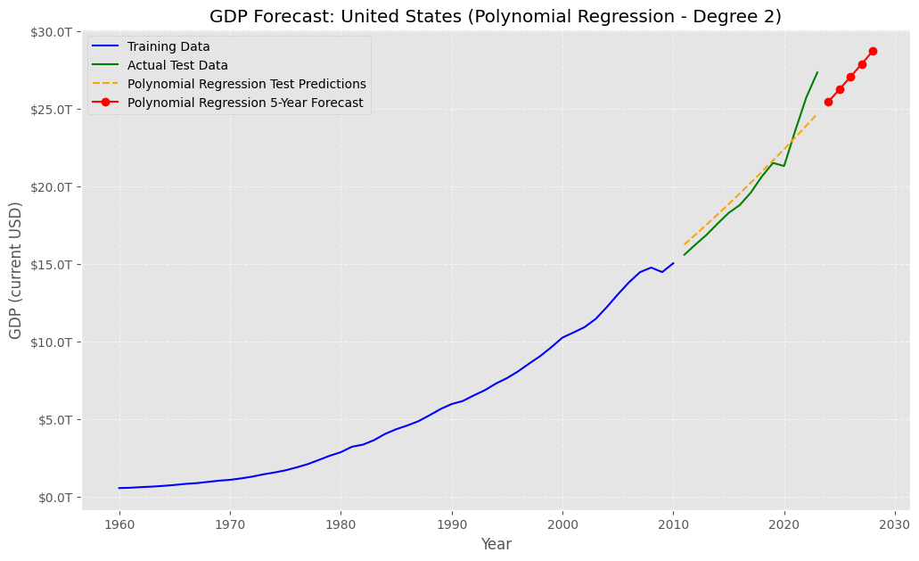
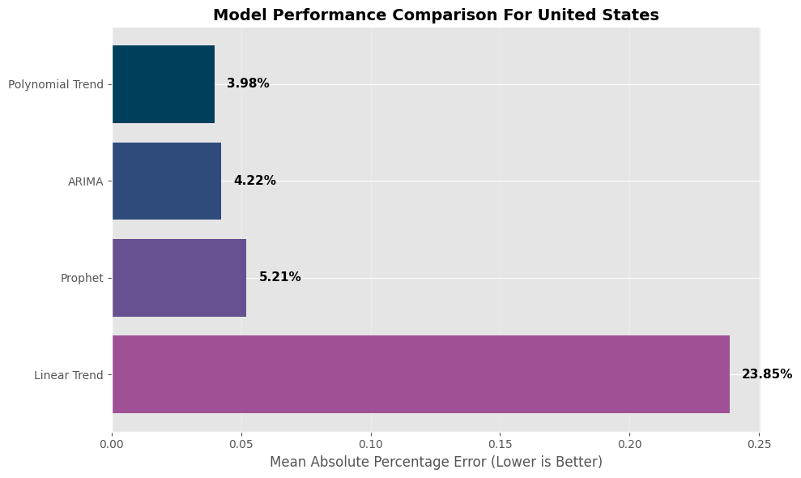
Forecasting (I): US Polynomial Regression with lowest predictive error capturing the US GDP growth trend
Key findings
Polynomial regression the best fit among the models tested
Linear Regression has a large error since the US’s GDP growth is exponential
ARIMA and Prophet more stable models

Slide 13
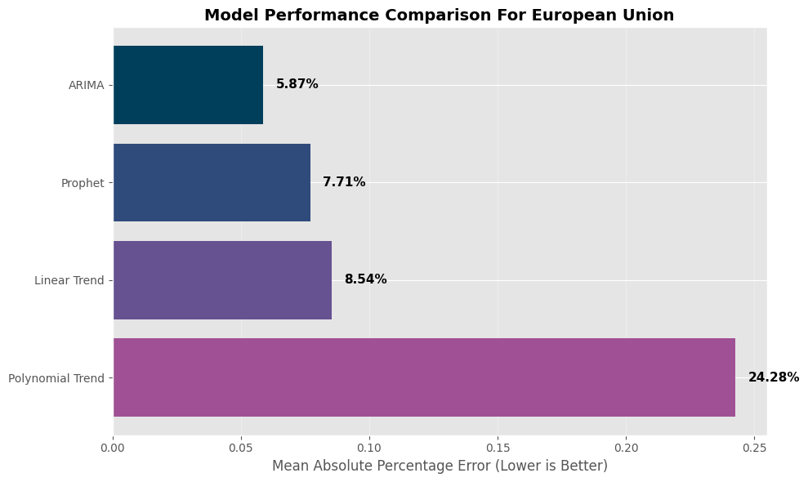
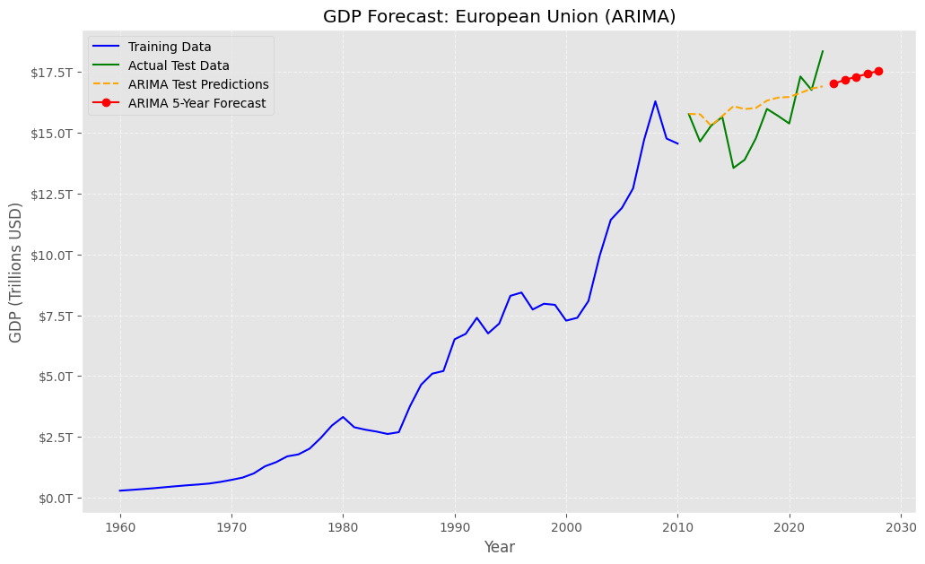
Forecasting (II): European Union ARIMA with the lowest predictive error (6%), but not fully capturing future growth
European Union’s trend seems to be linear
Most models performed well and had similar results apart from Polynomial Regression with an error of ~25%
ARIMA predicts well the growth trend of the EU GDP

Slide 14
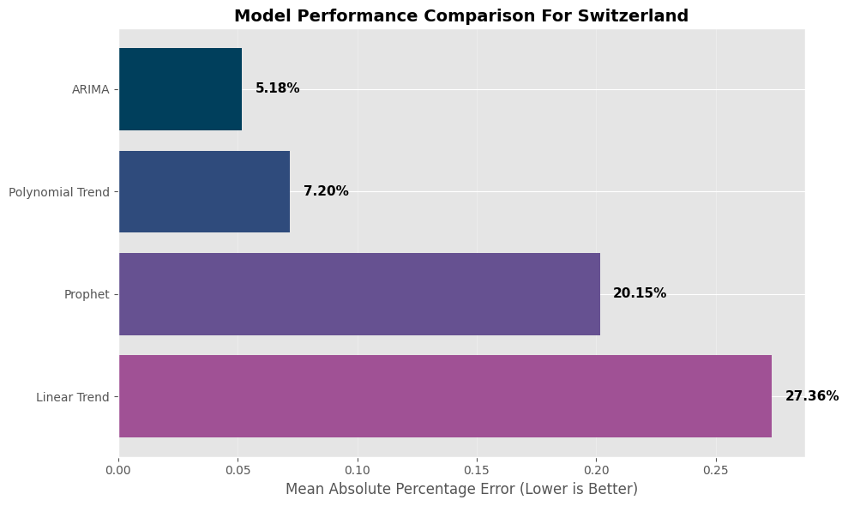
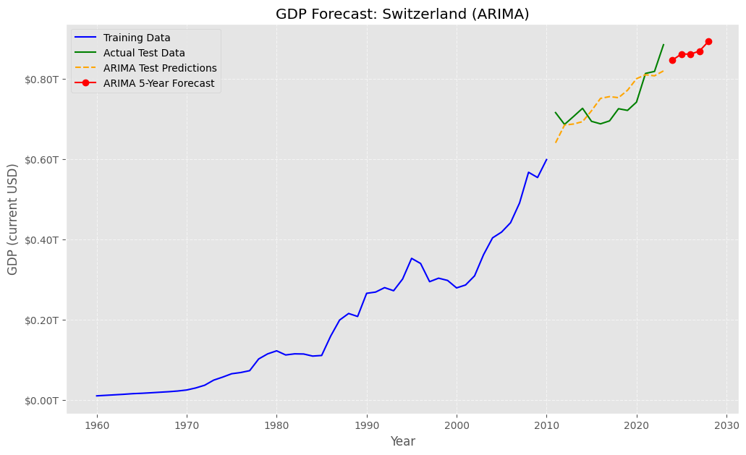
Forecasting (III): Switzerland ARIMA with the lowest predictive error (5%), while linear regression not as accurate (27% error)
Switzerland’s growth is somewhat exponential
A linear trend does not have good results, but a polynomial does
ARIMA very good predictions and close to actual results

Slide 15
Summarizing Model Accuracy ARIMA with lowest predictive error across countries (90% predictive accuracy)
Country | Linear MAPE (%) | Polynomial MAPE (%) | ARIMA MAPE (%) | Prophet MAPE (%)
Italy | 12.36 | 41.05 | 5.55 | 20.46
Germany | 6.56 | 15.72 | 4.6 | 5.21
France | 6.73 | 26.75 | 5.14 | 11.41
United Kingdom | 6.33 | 34.21 | 4.94 | 15.72
Canada | 24.65 | 13.34 | 8.43 | 17.62
United States | 23.85 | 3.98 | 4.22 | 5.21
Brazil | 37.39 | 73.58 | 9.53 | 37.67
Japan | 34.48 | 34.69 | 7.08 | 34.54
India | 59.07 | 32.99 | 5.45 | 58.86
China | 75.48 | 22.62 | 4.01 | 75.47
Angola | 88.52 | 112.83 | 30.99 | 88.44
Congo, Dem. Rep. | 28.23 | 6.47 | 6.51 | 28.24
Equatorial Guinea | 27.69 | 216.12 | 18.09 | 27.37
Nigeria | 44.99 | 22.57 | 12.44 | 44.85
Azerbaijan | 37.25 | 89.94 | 27.17 | 37.19
Iraq | 60.42 | 53.06 | 15.89 | 60.37
Oman | 46.84 | 14.52 | 10.49 | 46.75
Saudi Arabia | 52.14 | 31.09 | 10.93 | 52.06
United Arab Emirates | 32.07 | 65.64 | 8.09 | 32.01
Average | 37.11 | 49.96 | 10.50 | 36.81
ARIMA achieved the lowest average error and remained the most stable across all countries
Polynomial Regression was the worst performer overall
Forecasting was accurate for Western countries but faced significant challenges in African markets

Slide 16
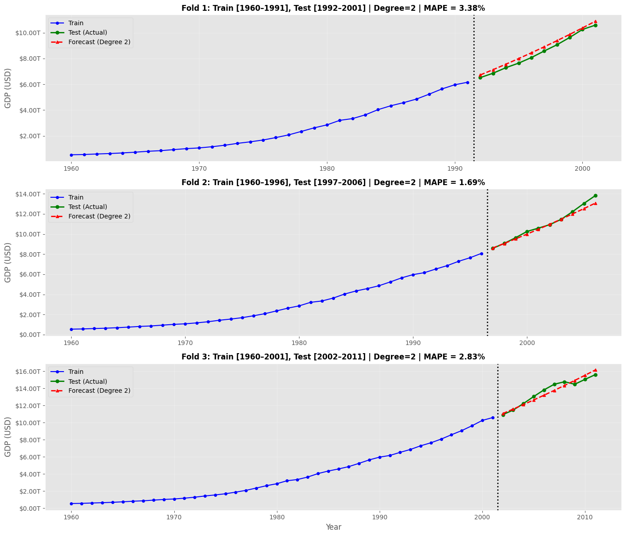
Backtesting Backtesting data show that Polynomial Regression is a stable model for US GDP prediction
Best Model: Polynomial Regression for the US
Backtesting
Train size increases with every fold
Test size remains the same
Shows stability of model

Slide 17
Agenda
Problem Statement – Project Details
Getting to know the data
Limitations and Improvements
Forecasting

Slide 18
Limitations and Improvements Challenges Identified and Opportunities for Enhancement
Limitations
Improvements
Ignores the “Real world”
Wars
Elections
Vulnerability to “Black Swan” events
COVID – 19
2008 economic crisis
Add more advanced models
LSTM
Prophet with use of MCMC
Other neural networks
Add more data to improve the models’ predictions
Population
Unemployment
Inflation

Slide 19
THANK YOU !

